Slide 1
suspicious JavaScript detect using machine learning
Hiram
CFS / IPS Research Team

Slide 2
Agenda
Background
Concept of Machine Learning
Sampling and Feature Map
Estimate Classifiers
Vista, Q&A.

Slide 3
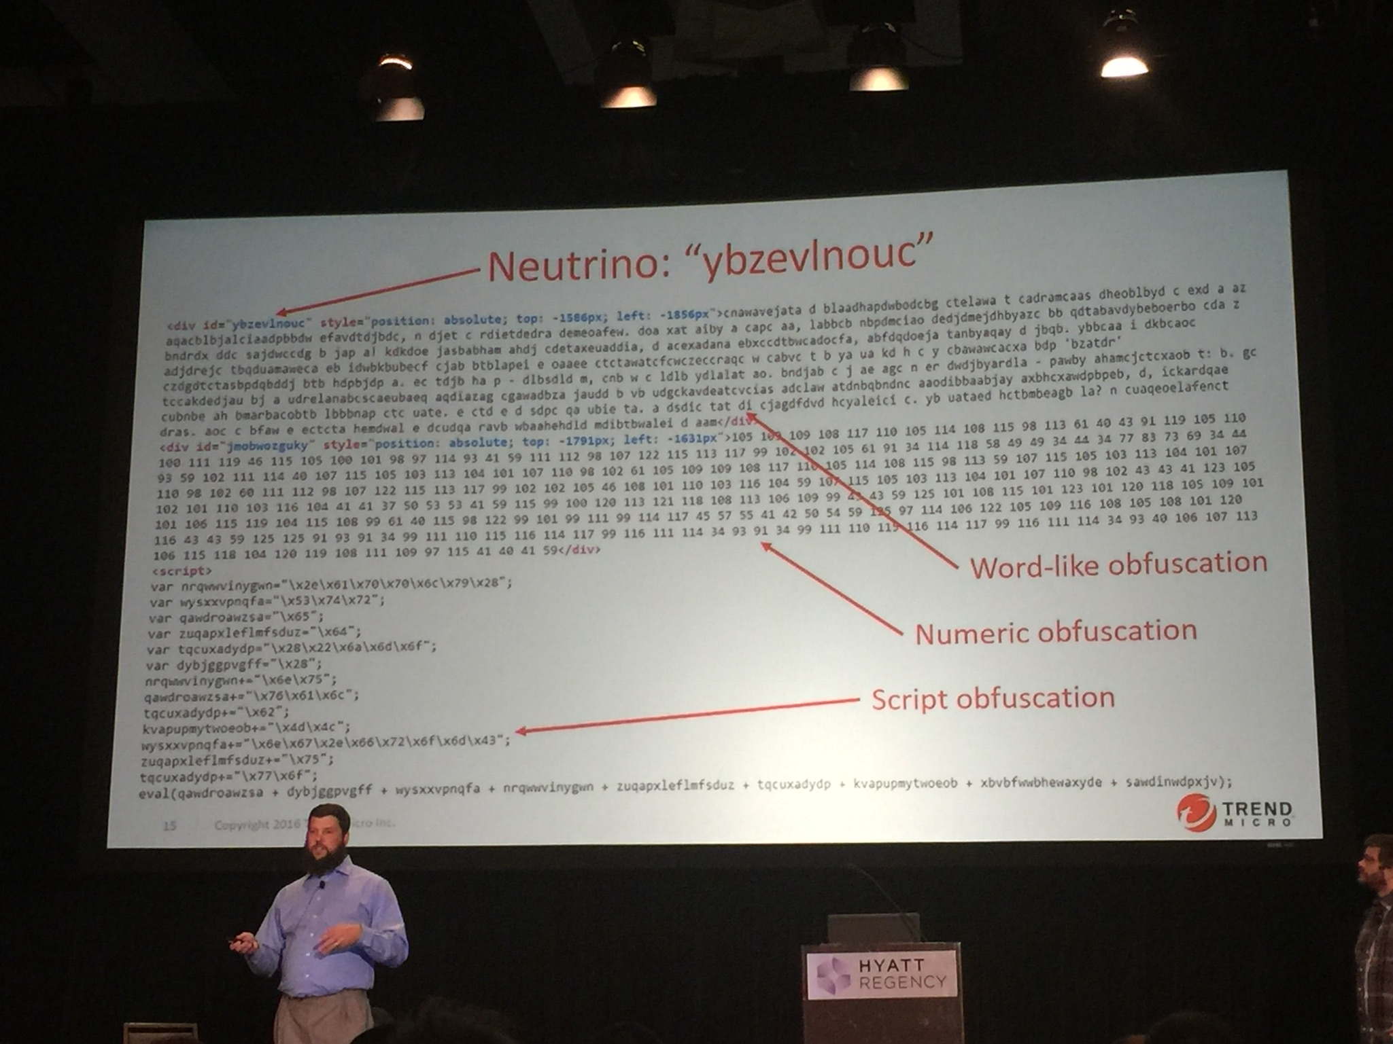
Background
The 10th International Conference on Network and System Security (NSS 2016)
Using Machine Learning to Stop Exploit Kits In-Line in Real-Time
Notes:
Link : http://nsclab.org/nss2016/

Slide 4
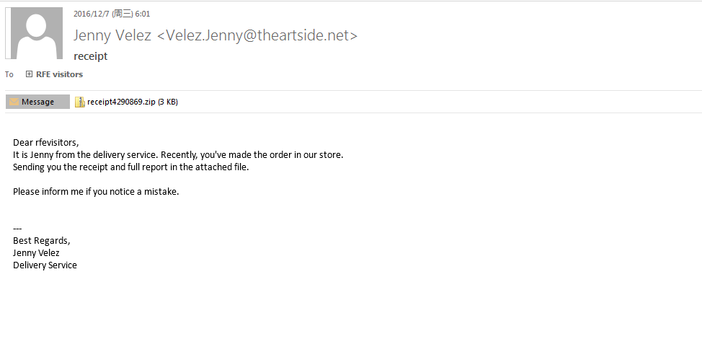
Background
Malicious JavaScript spread on Internet.
More News:
https://www.bleepingcomputer.com/news/security/the-week-in-ransomware-january-13th-2017-mongodb-apocalypse-spora-decryptors-and-more/

Slide 5
Machine Learning
Task: T, Measure: P , Experience E
Computer program can improve P in T with learning from E
Supervised Learning is where you have input variables (A) and corresponding output variables (B) . You use an algorithm to find a mapping function F which satisfy F(A)=B
Unsupervised Learning is where you only have input data (A) and no corresponding output. You use an algorithm to find the underlying structure or distribution of the data
Input | Output
2 | 4
3 | 9
4 | 16
… | …
9 | 81
10 | ?

Slide 6
Steps using Machine Learning
Define Problem
Prepare Data.
Evaluate Algorithms.
Improve Results.
Present Results.

Slide 7
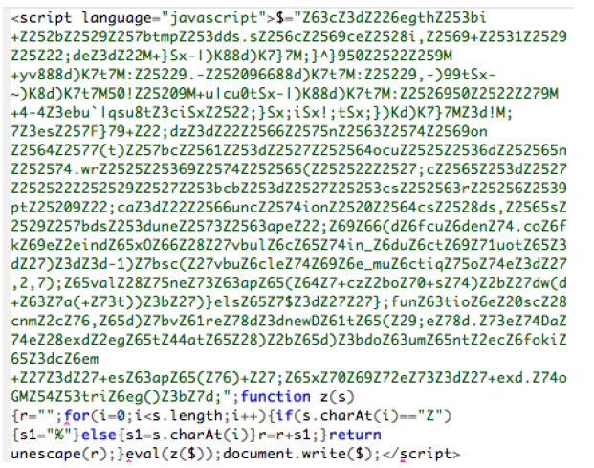
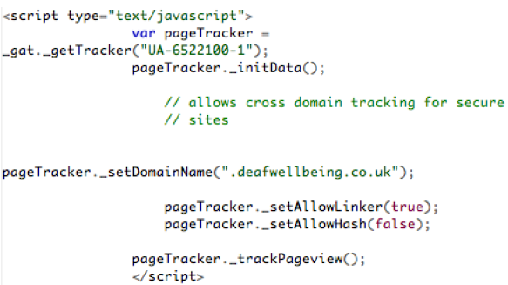
supervised learning IN suspicious JavaScript detect
JavaScript Samples Collect using Spider Scrapy
Benign: Alexa Top 500 http://www.alexa.com/topsites
Malicious: Malware.com https://malwr.com/
Datasets
Benign(28178)/ Malicious (657)/Unknown(161)
Benign JavaScript
Malicious JavaScript

Slide 8
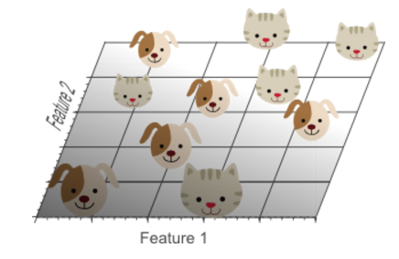
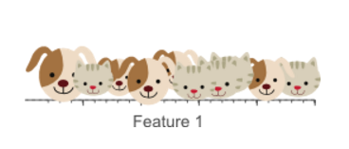
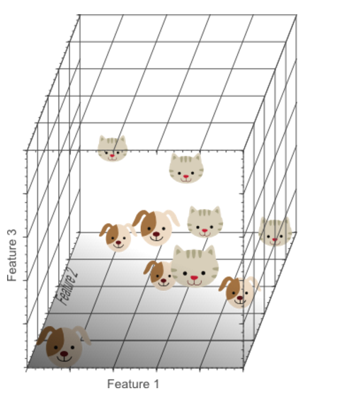
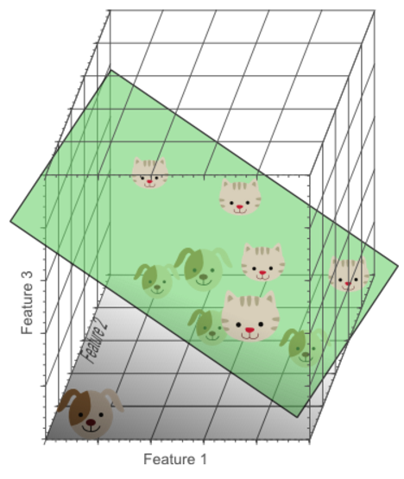
Number of Features
A single feature does not result in a perfect separation
A second feature still does not work
A third feature result
In a reasonable solution

Slide 9
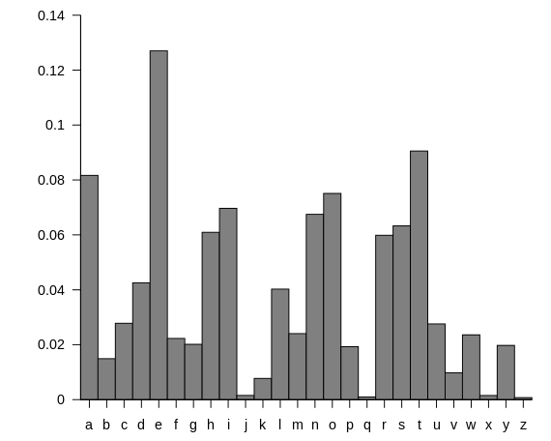
features selected- Statistical
Why Statistical?
“Happy families are alike;
Unhappy family is unhappy in its own way”
-- Leo Tolstoy
Letter Frequency in English Language

Slide 10
Token Features Extract from JavaScript
Example for token type statistics, Using JavaScript Lexer
(function ($) {
Drupal.behaviors.commentNotify = {
attach: function (context) {
$('#edit-notify', context)
.bind('change', function() {
$('#edit-notify-type', context)
[this.checked ? 'show' : 'hide']()
.find('input[type=checkbox]:checked').attr('checked', 'checked');
})
.trigger('change');
}
}
})(jQuery);
lparen function lparen id rparen lbrace id period id period id eq lbrace id colon function lparen id rparen lbrace id lparen string comma id rparen period id lparen string comma function lparen rparen lbrace id lparen string comma id rparen lbracket this period id condop string colon string rbracket lparen rparen period id lparen string rparen period id lparen string comma string rparen semi rbrace rparen period id lparen string rparen semi rbrace rbrace rbrace rparen lparen id rparen semi
All Tokens

Slide 11
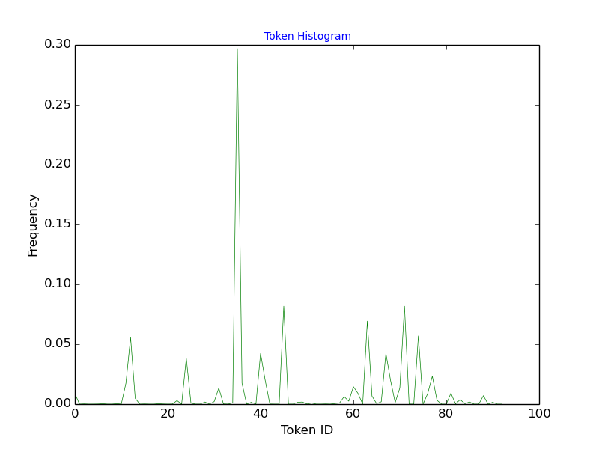
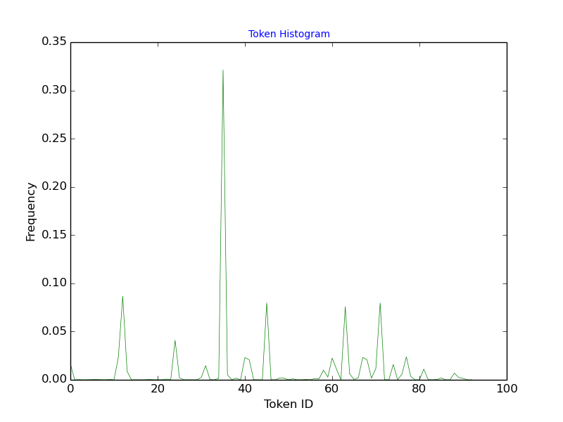
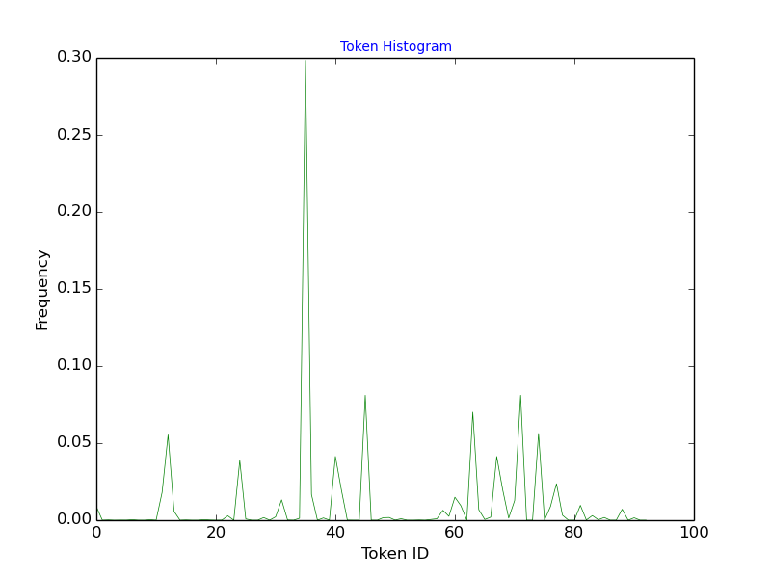
Example-Benign
Jquery 3.1.1
Jquery 3.1.1.min
Jquery 2.2.4

Slide 12
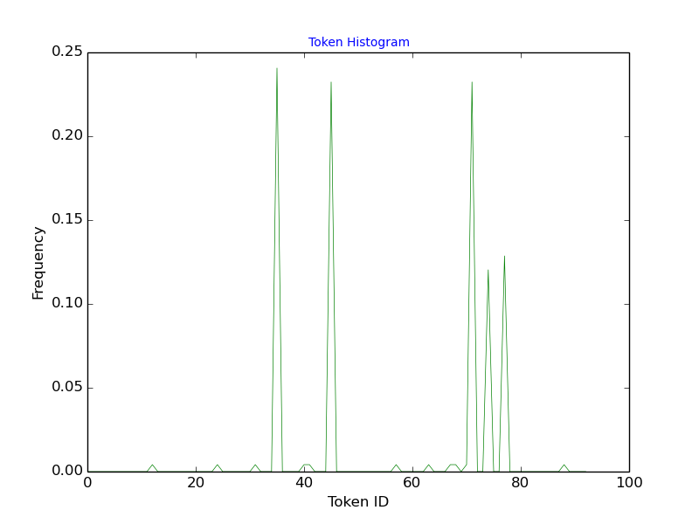
Example-Malicious Variant
A ransomware sample
A ransomware sample variant

Slide 13
Training and Find PROPER classifier
Evaluation Indicators
TP: A positive sample, system label it as positive; FP: A negative sample, system label it as positive;
TN: A negative sample, system label it as negative; FN: A positive sample, system label it as negative
Name | Description | Comment
Precision | TP/TP+FP | In all labeled positive(s) by the system, how many of them are really positive
Accuracy | TP+TN/TP+FP+TN+FN | The system make a correct decision, Label positive as positive or negative as negative
Recall(TPR) | TP/TP+FN | The system’s ability to find real positive from positive samples
F1 | 2*Recall*Precision/Recall + Precision | Harmonic mean for Recall and Precision
FPR | FP/TN+FP | System make a mistake, label negative as positive

Slide 14
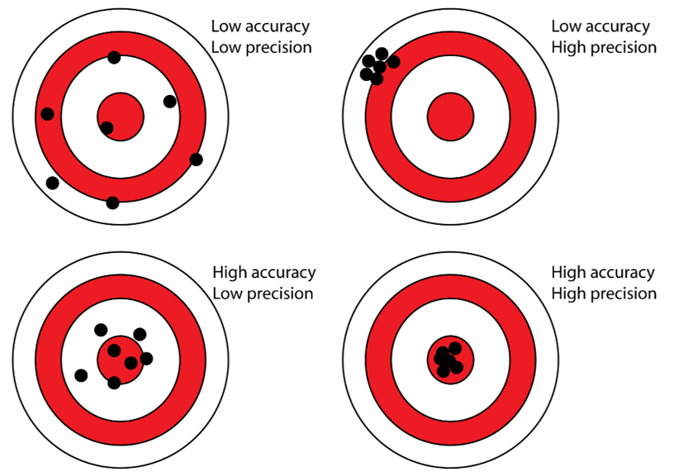
Training and Find PROPER classifier
Evaluation Indicators
1
2
3
4

Slide 15
Training and Find PROPER classifier
Classifiers (using scikit-learn)
K-nearest neighbors (KNN)
Naive Bayes
Linear regression & Logistic Regression
Decision Tree & Random Forest

Slide 16
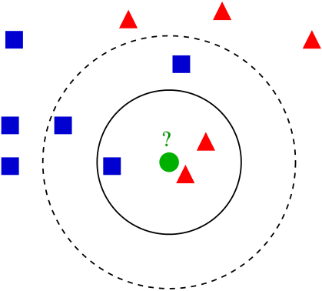
k-nearest neighbors (KNN)
K < √ number of training samples

Slide 17
Naive Bayes
P(A|B) = P(AB)/P(B), P(B|A) = P(AB)/P(A) => P(A|B) = P(B|A) P(A) / P(B)
Generalize: P(A|B₁B₂...B_{n}) = P(B₁B₂...B_{n} |A)P(A) / P(B₁B₂...B_{n})
Example: Spam classification
An e-mail contains “Buy” and “Cat”, is it spam?
Mail ID | Love | Buy | Deal | Cat | Spam
1 | 1 | 0 | 0 | 1 | No
2 | 0 | 1 | 1 | 0 | Yes
3 | 0 | 1 | 1 | 1 | Yes
4 | 1 | 0 | 1 | 1 | No
5 | 1 | 1 | 0 | 0 | No
6 | 0 | 1 | 0 | 1 | ?
P(Spam| Buy, Cat) = P(Buy, Cat | Spam)*P(Spam)
= 1*0.5*0.4=0.2
P(Not Spam| Buy, Cat) = P(Buy, Cat | Not Spam)*P(Not Spam)
= 0.33*0.67*0.6 = 0.13
Conclusion: More like a spam

Slide 18
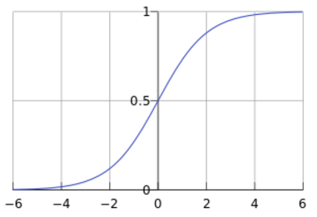
Linear regression AND Logistic Regression
Linear regression:
Y = F(x) = ɵ₀+ɵ₁*x₁+ɵ₂*x₂+…….+ɵ_{n}*x_{n}
Logistic Regression:
Y = H(F(x)), H(x) = 1/(1+e^{-x}).
Y>= threshold Yes
Y<threshold No
H(x)

Slide 19
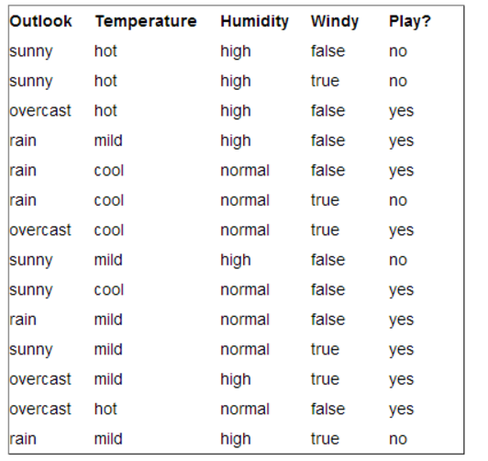
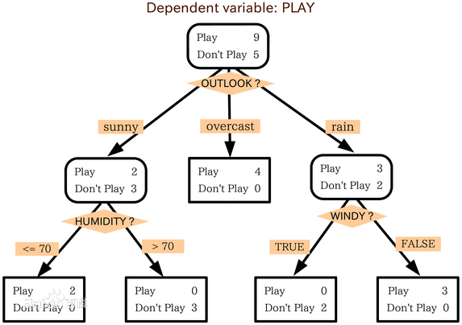
decision tree and Random forest

Slide 20
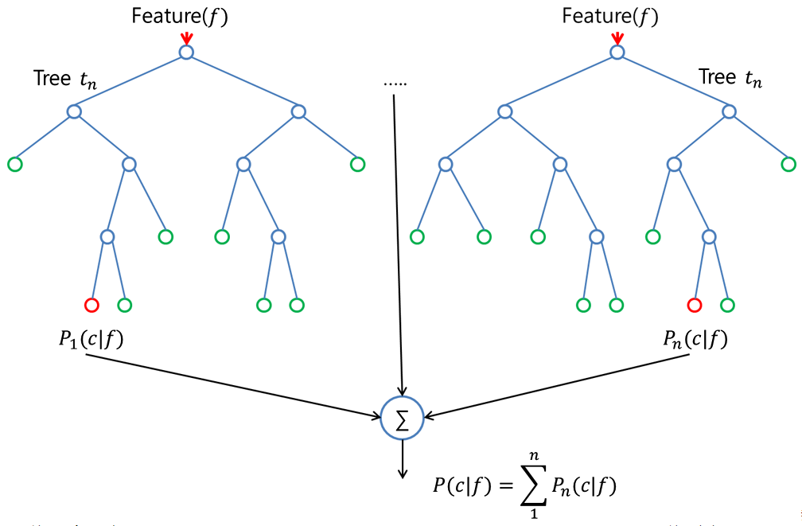
decision tree and Random forest
Random decision forests correct for decision trees' habit of overfitting to their training set

Slide 21
Data Flow
Samples Collecting
KNN
Naive
Bayes
X Benign/
Y Malicious
Training Set
Classifiers
Logistic Regression
Random
Forest
Historical Samples
Feature
10000 Benign/
100 Malicious
Validation
Test
Model
Confirm & feed
Evaluate
Best Model
New Samples
Predict

Slide 22
COMPARASION FOR DIFFERENT classifiers
Round/Classifier | KNN | Naive Bayes | Logistic Regression | Random Forest
Round 1 | [0.9968, 0.81] | [0.8717, 0.07] | [0.9934, 0.63] | [0.9996, 1]
Round 2 | [0.9963, 0.78] | [0.8875, 0.08] | [0.9923, 0.6] | [0.9997, 1]
Round 3 | [0.9971, 0.8] | [0.857, 0.06] | [0.9943, 0.67] | [0.9997, 0.98]
Round 4 | [0.9963, 0.77] | [0.8924, 0.08] | [0.993, 0.62] | [0.9997, 0.99]
Round 5 | [0.997, 0.82] | [0.8735, 0.07] | [0.9924, 0.6] | [0.9996, 0.99]
Performance for different classifiers: [Accuracy, Precision]
on test dataset: Benign(10000)/Malicious(100)

Slide 23
Training set Composition for Random forest
Malicious /Benign | 100 | 500 | 1000 | 2000 | 5000 | 10000 | 15000
50 | [0.88, 0.34] | [0.72, 0.78] | [0.64, 1.0] | [0.62, 0.95] | [0.57, 1.0] | [0.54, 1.0] | [0.55, 1.0]
100 | [0.94, 0.21] | [0.84, 0.78] | [0.84, 0.92] | [0.83, 0.98] | [0.77, 1.0] | [0.72, 1.0] | [0.68, 1.0]
200 | [0.97, 0.16] | [0.93, 0.72] | [0.9, 0.82] | [0.89, 0.96] | [0.86, 1.0] | [0.84,1.0] | [0.83, 1.0]
300 | [0.98, 0.15] | [0.95, 0.56] | [0.94, 0.77] | [0.95, 0.91] | [0.94, 1.0] | [0.94,1.0] | [0.93, 1.0]
400 | [0.98, 0.12] | [0.98, 0.51] | [0.96, 0.74] | [0.96, 0.87] | [0.96, 0.96] | [0.96,0.99] | [0.95, 1.0]
500 | [0.99, 0.12] | [0.99, 0.42] | [0.98, 0.59] | [0.98, 0.76] | [0.97, 0.97] | [0.97,0.98] | [0.98, 0.99]
Performance for different sample composition : [Recall, Precision]
on test dataset: Benign(10000)/Malicious(100)

Slide 24
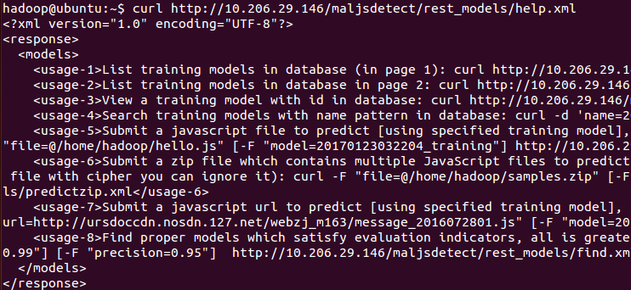
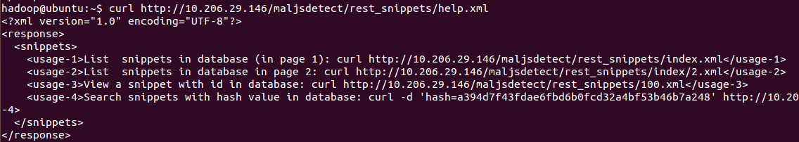
Restful api
RESTful API for Training Model
RESTful API for Snippets

Slide 25
Q&A
Thank You!
Q&A

